Slide 1
CLOUD RESOURCES:
THE BASICS

Slide 2
What is a “Cloud Resource”
The Core Idea: A cloud resource is a fundamental, on-demand IT asset—like computing power, storage, or networking—that you access over the internet.
A Simple Analogy: Think of it like a public utility.
  You don't build your own power plant; you simply connect to the grid and pay for the electricity you use.
  In the same way, you don't buy and manage your own physical servers; you connect to a cloud provider's network and use the resources you need, when you need them.
Key Characteristics:
  On-Demand: You can get these resources instantly, without human intervention.
  Pay-as-you-go: You only pay for what you use, turning a large upfront cost into a simple operating expense.
  Elastic: You can easily scale up or down to meet demand, paying for peak usage only when it's needed.

Slide 3
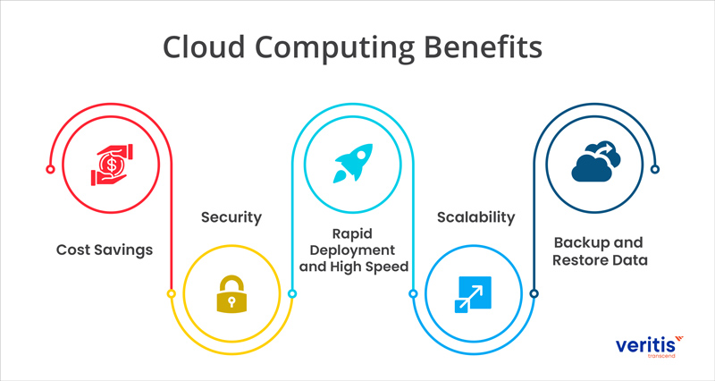
The "Why": Driving Cloud Adoption

Slide 4
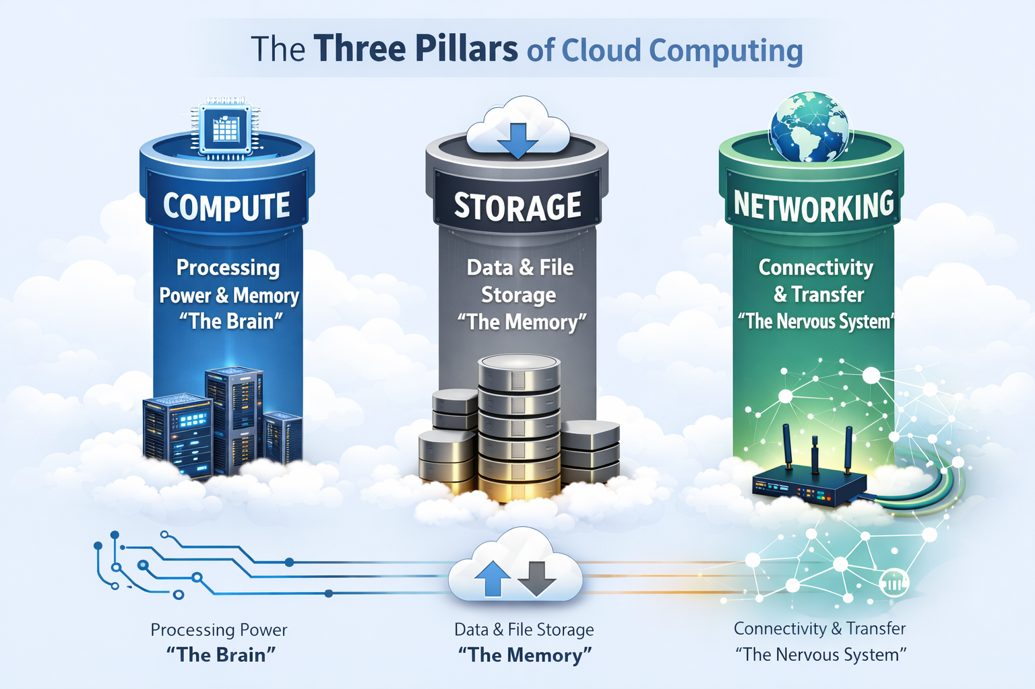
Three Pillars
The Pillars:
Compute: The processing power and memory. It’s the "brain" of your cloud presence.
Storage: The persistent space where you save your data and files. It's the "memory" of the cloud.
Networking: The infrastructure that connects your resources, allowing them to communicate with each other and with the rest of the internet. It's the "nervous system."

Slide 5
Compute: The Engine of the Cloud
What it is: Provides the computational power necessary to execute your applications, services, and workloads.
What it is: Persistently store and retrieve your digital information.
Common Resources:
Block Storage: Raw storage volumes attached to compute instances (like virtual hard drives); ideal for databases and operating systems.
File Storage: Shared, hierarchical storage accessed via file paths; commonly used for shared files, content management, and home directories.
Object Storage: Stores data as objects with metadata in a flat structure; highly scalable and cost-effective for backups, media, and archives.

Slide 6
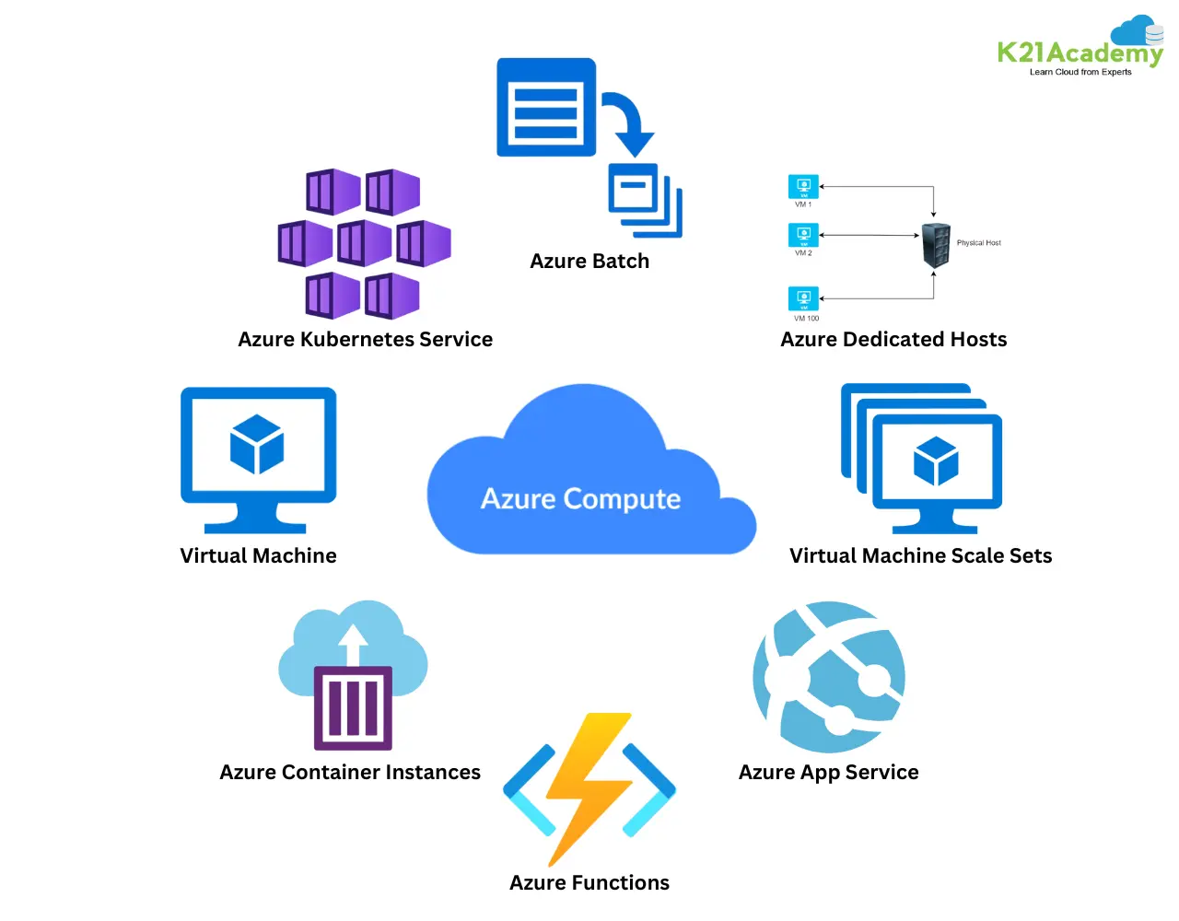
Compute: The Engine of the Cloud
What it is: Provides the computational power necessary to execute your applications, services, and workloads.

Slide 7
Storage: The Data Repository
What it is: Persistently store and retrieve your digital information.
Common Resources:
Block Storage: Raw storage volumes attached to compute instances (like virtual hard drives); ideal for databases and operating systems.
File Storage: Shared, hierarchical storage accessed via file paths; commonly used for shared files, content management, and home directories.
Object Storage: Stores data as objects with metadata in a flat structure; highly scalable and cost-effective for backups, media, and archives.

Slide 8
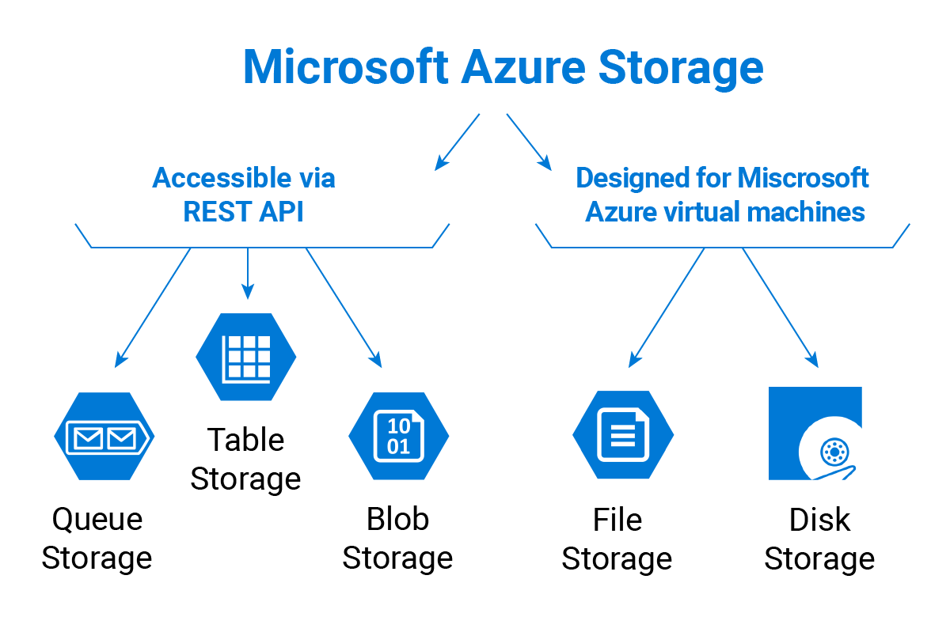
Storage: The Data Repository

Slide 9
Networking: The Connectivity Fabric
What it is: The infrastructure that connects your cloud resources and manages traffic to / from the internet.
Common Resources:
Routing / Switching: The means by which data flows between individual compute and storage nodes in or between networks. Routing / switching is generally accomplished via internet protocol (IP), which assigns unique numerical identifiers to devices for communicate over a network, although different protocols exist for specific networking purposes.
Security and Access Control: Resources that limit or grant access to specific resources. This can generally be accomplished using either network-oriented means (example: access control lists (ACLs)) or role-based means (example: Microsoft Active Domain / Entra).

Slide 10
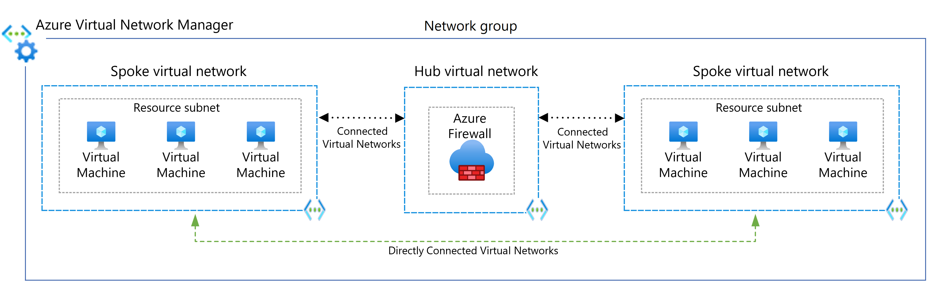
Networking: The Connectivity Fabric

Slide 11
The Shared Responsibility Model
The Shared Responsibility Model partitions specific requirements and privileges for cloud resource access and maintenance between a cloud service provider and customer.
Cloud Provider's Responsibility: Starts with security of the cloud (the physical data centers, the hardware, and the underlying services) and progresses up from there.
Customer Responsibility: Starts with securing customer-specific resources (securing data, managing user access, and configuring resources correctly) and progresses down from there.

Slide 12
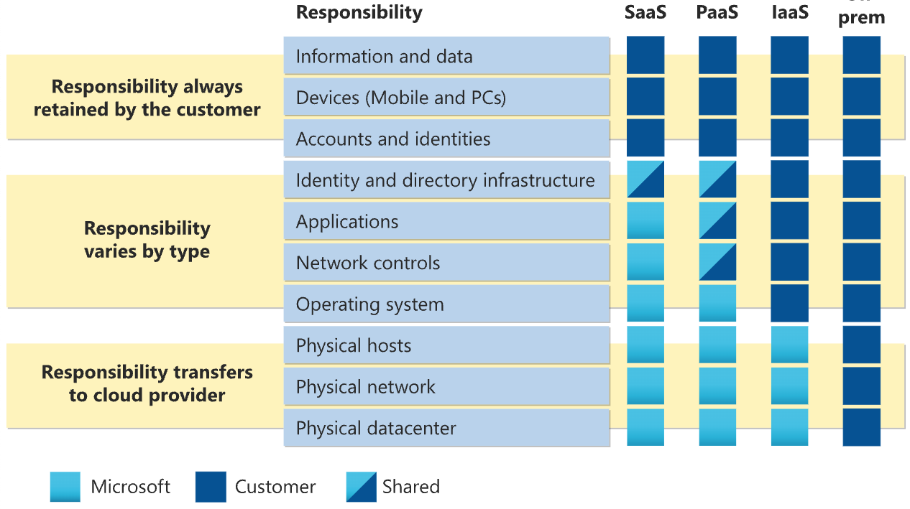
Visual Shared Responsibility Model

Slide 13
Real-World Example: Let’s Build it!
The Components:
Compute: Virtual Machine.
Storage: Azure Files refers to the overall service that provides fully managed file shares in the cloud. Think of as "file share drives" or network drives that you can mount and access from your cloud or on-premises deployments.
Networking: A virtual private cloud (VPC) to create a secure, private network.

Slide 14
Questions?
Artificial Intelligence
Integration Center

